Slide 1
Impermanence
And the
purpose of life

Slide 2
Life is a journey
Life is described as a journey. We travel from one day to the next, and from place to place, always moving forward in time. We cannot go backwards in time.

Slide 3
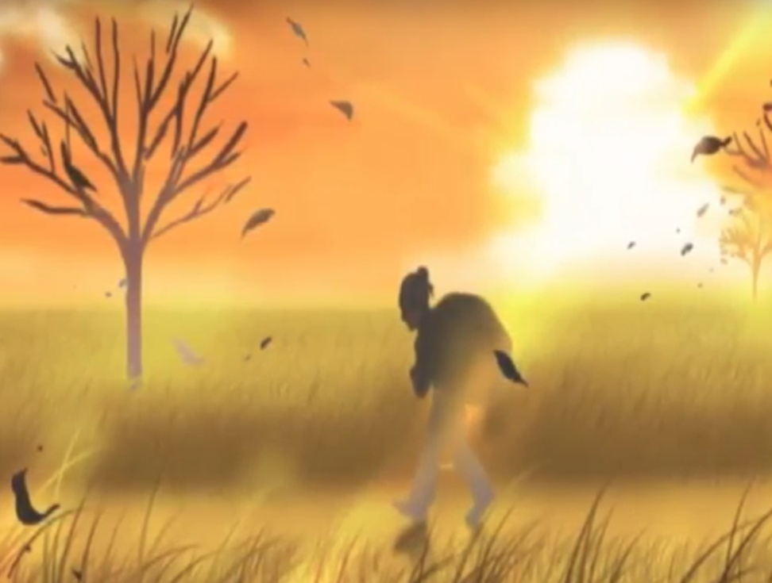
On a journey we have destination. What is our destination in life?

Slide 4
The 100% certain destination for all people is the afterlife.
It could be said that we are all on a journey towards death.

Slide 5
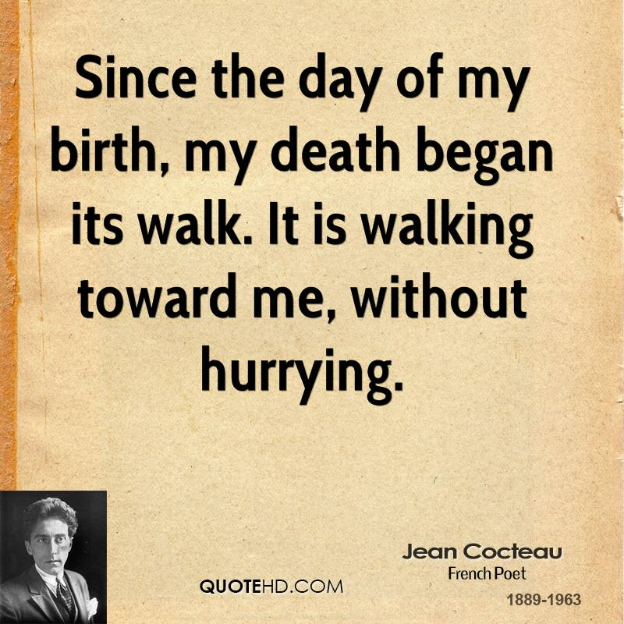

Slide 6
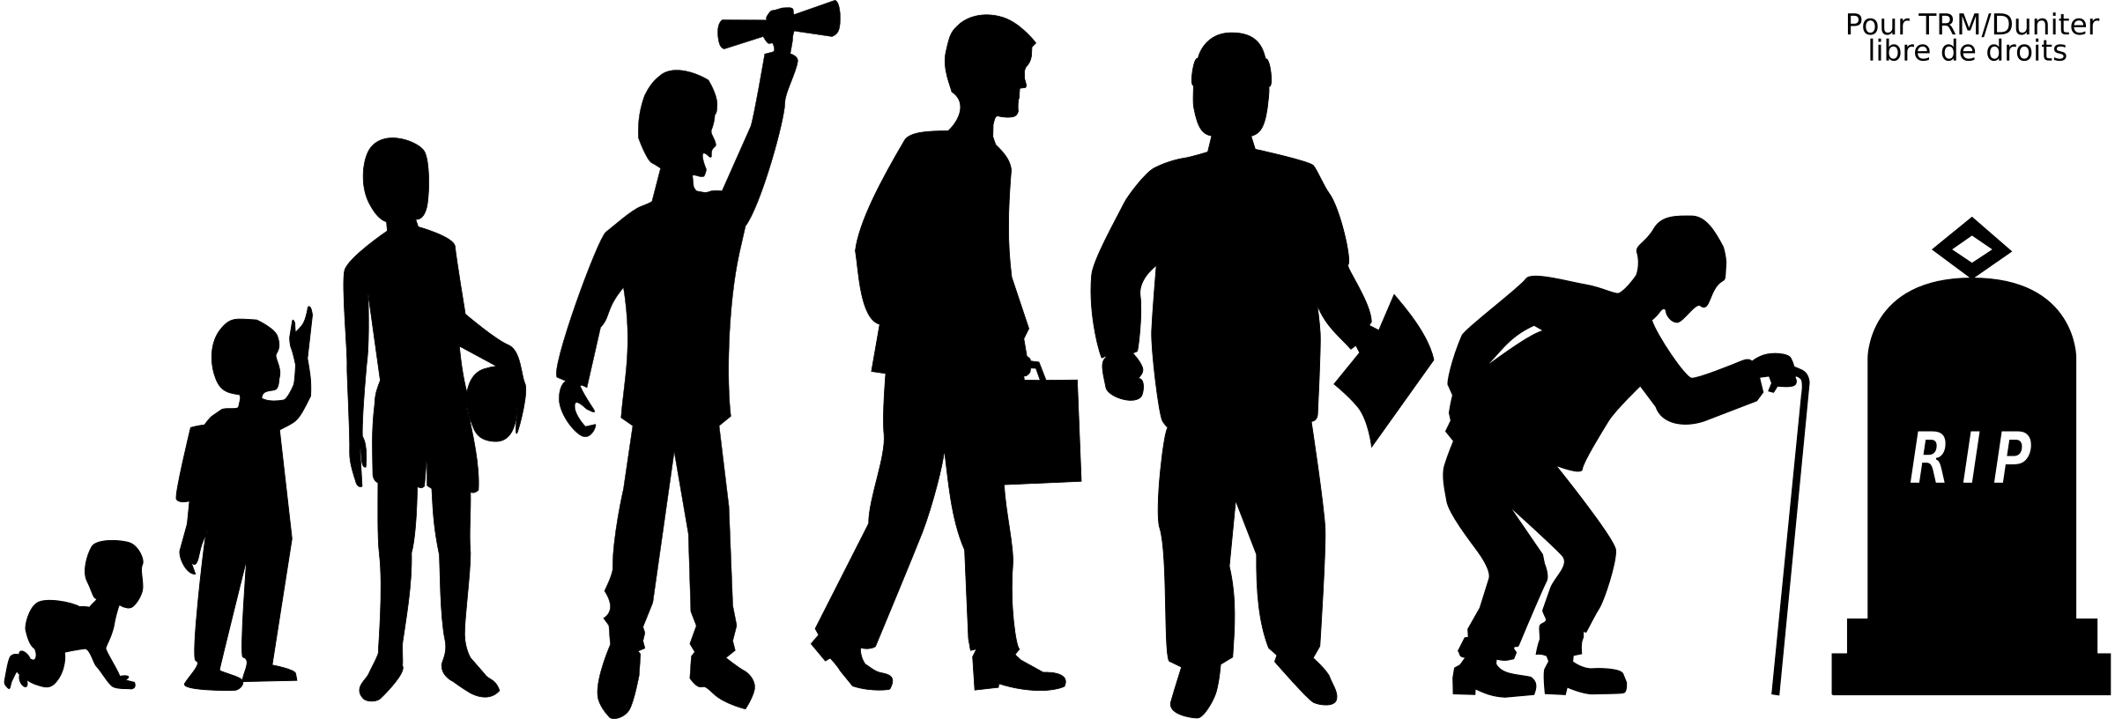
This means that as soon as we are born we have started on a journey toward the afterlife.

Slide 7
It is said that life and death are like two sides of a sheet of paper – they are inseparable.
Something that is born, must be die. Even for Buddha (Sakyamuni).

Slide 8
This is a future we cannot avoid, even if we stop all the clocks. The afterlife is 100% assured.

Slide 9
Impermanence means that “all life ends.”
Something that was living must die. Something that has appeared, must disappear.

Slide 10
“When he was nearly fifty, the great Russian writer Leo Tolstoy realized this.”
Page 68 of REASON

Slide 11
No one leaves their home in the morning thinking that this will be the last time leaving their home.
Yet people leave their homes in the morning, healthy, but don’t return home in the evening.

Slide 12
No one expects their last day to be their last day.
However, death has other ideas.

Slide 13
“Death comes when by rights it has no business coming. It goes coolly where by rights it has no business going, like a desperado striding with dirty boots into a freshly cleaned parlor. Death’s behavior is outrageous. You may ask it to wait a while, but in vain. Death is a monster beyond human power to budge or to hold in check.”
(page 38)

Slide 14
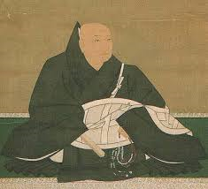
500 years ago the Buddhist monk, Rennyo said,
“Hence we may have radiant faces in the morning, but in the evening be no more than white bones.”

Slide 15
The Roman philosopher Seneca, wrote:
REASON page 37
“Whatever can happen at any time can happen today.”
Her husband’s death happened “at the end of a perfectly ordinary day.”

Slide 16
Public clocks in Europe in the Middle Ages (5th to 15th Century) were decorated with the Latin words: “Ultima Forsan” meaning, “Perhaps the last [hour].”

Slide 17

Timepieces were formerly an apt reminder that our time on Earth grows shorter with each passing minute.

Slide 18
Sudden or premature death was common in the medieval period. People lived to an average age of 30.
“People often worried about ‘sudden death’ (whether in battle, from natural causes, by execution, or an accident) and what would happen to those who died without time to prepare and receive the last rites.”

Slide 19
But if we think about it, this has not changed today, or will not in the future. Human life has always been fleeting and unpredictable. We don’t know when our last hour will be, but for sure it will come. Are we prepared?

Slide 20
Life is short and shortly it will end
Death comes quicker than you think.
It takes everything away,
but takes pity on no one.
We hasten towards death…
-Vermell de Montserrat, 1399
But are we prepared?

Slide 21
What does it mean to be prepared?
This is the purpose of listening to Buddhism.

Slide 22
People prepare for old age, which may never come, but no one prepares for death which for sure will come.
The sole purpose of listening to Buddhism is to clarify what happens in the afterlife.

Slide 23
We have a destination
Every journey has a destination. But on this journey of life we don’t know what awaits us in the destination of the afterlife. Our destination is therefore “dark.” We are ignorant of this certain future. We are like ignorant travelers on a journey.

Slide 24
“Because we are running in the dark, nothing we may happen to pick up along the way can provide heartfelt cheer.” (p.41 REASON)
For this reason we cannot have true peace of mind now.

Slide 25
Our greatest issue is this darkness of the afterlife. However, we are not concerned about it. We don’t want to look at it. For this reason it is the greatest concern.

Slide 26
“All this time it was only other people who died, or so I had assumed. Now the thought of my own death is more than I can bear.”
- A physician on his deathbed
The afterlife is a matter of “now.” But we don’t feel that we will die now. We think death is an event far into the future.

Slide 27
Confronting death
Tiger in a cage = Death as we imagine it.
Tiger in the mountain = the real experience of death.
(REASON page 64)

Slide 28

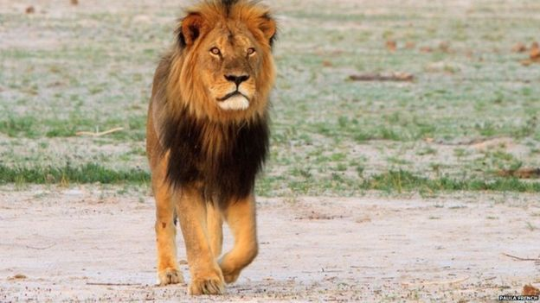
Lion in a cage; lion in the jungle
In a cage; we can
watch unconcerned.
But cannot feel the same way face to face in the jungle.

Slide 29
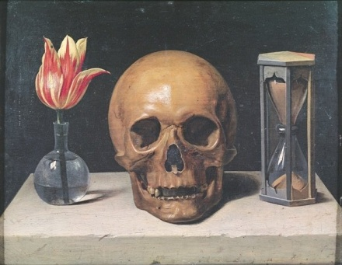
Memento Mori
A phrase from
the middle ages:
“Memento Mori”
“Remember you are mortal.”
If we truly felt we will die we would not have to be reminded like this.
“Memento Mori”
“Remember You are mortal”

Slide 30

We think we will never die
Try to walk on your shadow, and it keeps walking away from you.
If you are asked, “Will you die tomorrow?” you will probably answer, “no.”
And tomorrow you are asked the same question, you will reply with the same answer, and so on.

Slide 31
We have a mind that thinks it will never die.
Yet, death has other plans. Death can happen at the most unexpected time.

Slide 32
“Death always comes suddenly. No matter when it appears, the one visited by death looks on its arrival as a sudden intrusion. For the mind filled with a sense of security is totally unprepared for death.” (P.36 REASON)

Slide 33
Buddhism teaches that we have a mind that is insensitive to death.
This is the “mind filled with a sense of security”

Slide 34
We are not aware of how short life is. We think it is long, but this is a delusion, taught Buddha.
Buddha asked his disciples how quickly they think life passes.
He told the story of the 4 Arches.

Slide 35
4 archers, one facing north, south, east and west, shoot an arrow off at the same time. As soon as they shoot, a man must run and catch all the arrows before they fall to the ground.
He must run at lightening speed. This is how fast Buddha said our life passes. But we are not aware of this fact.

Slide 36
Buddhism teaches that because death is a future that we cannot avoid, our greatest problem is the issue of what happens when we die.

Slide 37
The suggestion that people’s purpose in life all differs ignores the universal problem of death.

Slide 38
A decayed tooth that causes an occasional twinge in the early stages, will, left untreated end in sleepless agony.
The longer we ignore our certain future, the more fearful and troublesome it becomes.

Slide 39
Confronting death does not mean sliding vainly into depression.
Confronting death is the first step towards making the moments of our life outshine the sun.

Slide 40
“Look death squarely in the face, know the root cause of suffering and see it eliminated.”
Then we will attain true peace of mind and satisfaction. Absolute Happiness.

Slide 41
It is salvation (true happiness) in this lifetime.
Buddhism is a teaching for the living, not the dead. Sakyamuni Buddha did not conduct funeral services. And Master Shinran’s teachings are focused on salvation “now”, while alive.

Slide 42
Amida Buddha’s Vow is to grant true happiness while alive.
However, people imagine only a happiness after death.

Slide 43
Without knowing the existence of true and lasting happiness in this lifetime, we are living just to die.

Slide 44
What is there in life that we can attain that will never forsake us?
This is called “Absolute happiness” that was taught solely by Sakyamuni Buddha.

Slide 45
Absolute happiness is something that will never leave us, even at death.
This is why it is called the universal and true purpose of life.

Slide 46
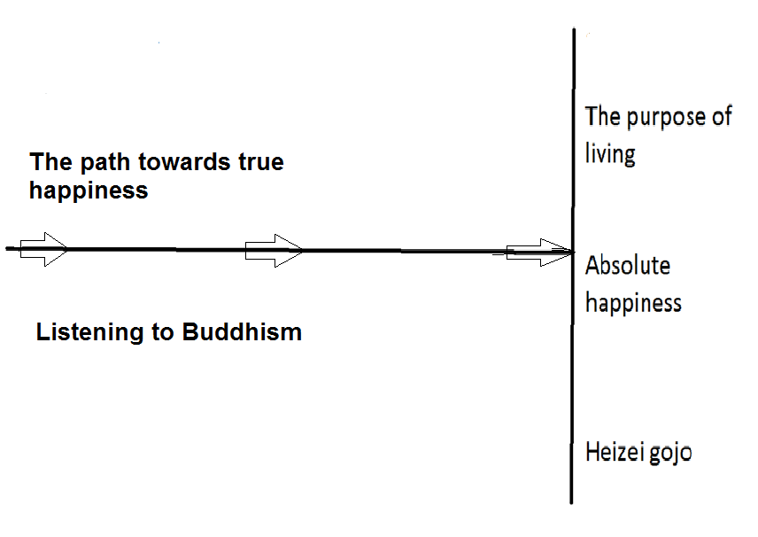
Horizontal and vertical line

Slide 47
When we keep listening to Buddhism, a time will come when our journey to Absolute happiness is complete.
This is called completion of life’s purpose in this lifetime.
Please keep listening until then.

Slide 48
End

