Slide 1
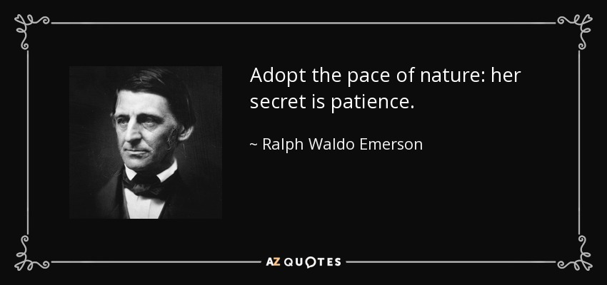
Topic: Patience

Slide 2
Buddhism teaches about the “6 Good Deeds”
Kindness/Generosity
Keeping a promise
Patience
Making Effort
Self-reflection
Self-improvement/Wisdom

Slide 3
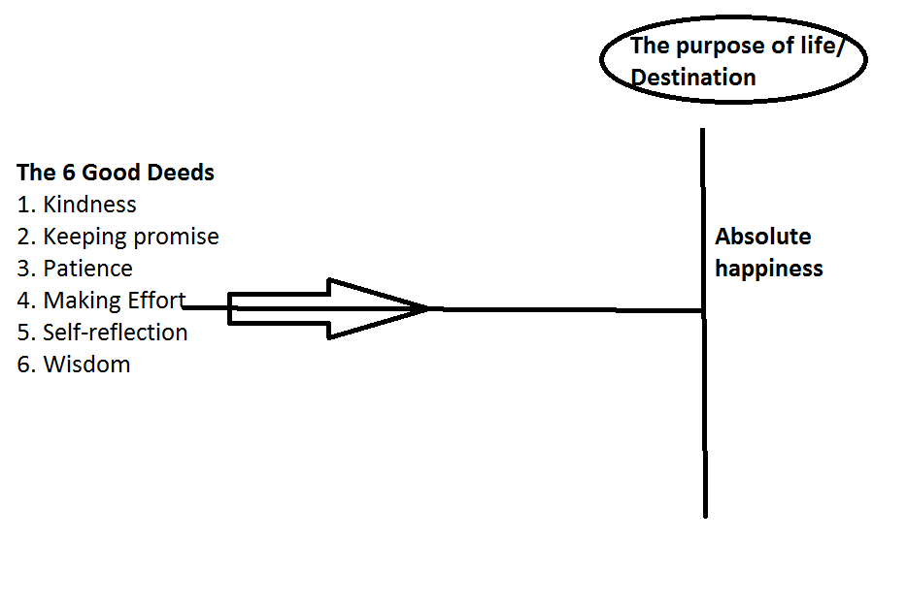
Buddhism teaches that doing good deeds are the means to the destination

Slide 4
Why Patience Is A Good Deed
“Patience is a virtue”: Definition of “virtue” is “behavior of high moral standard.” Practicing the 6 Good Deeds is hard. Patience is difficult, isn’t it?
Patience makes us happy. How?
Patience brings peace. Peace makes us happy.
Patience is the opposite of anger and so is beneficial for health.

Slide 5
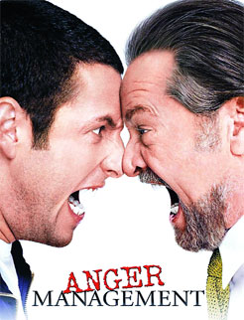
Why Anger Is Bad
Anger is one of the “10 bad deeds” taught Buddha.
Anger damages relationships
Anger hurts our health
Anger = turmoil

Slide 6

Effects Of Anger On Health

Slide 7
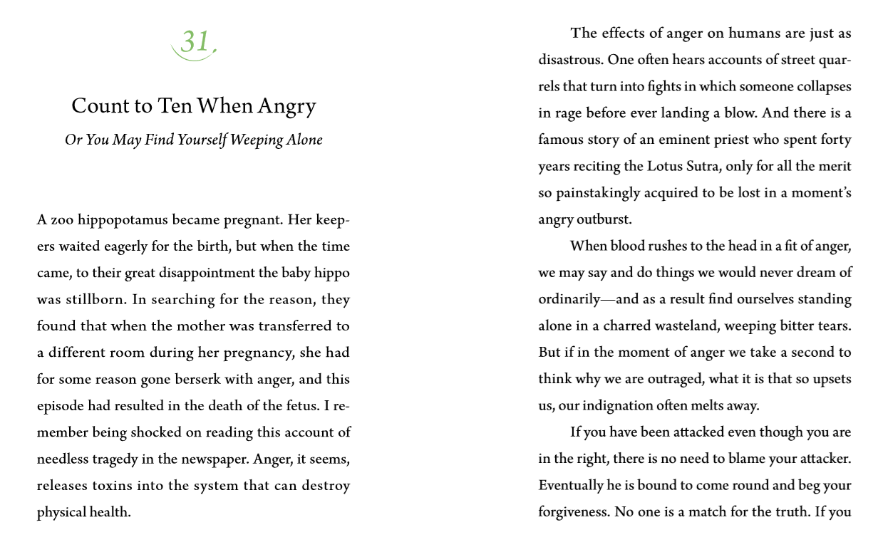
Something You Forgot #31

Slide 8
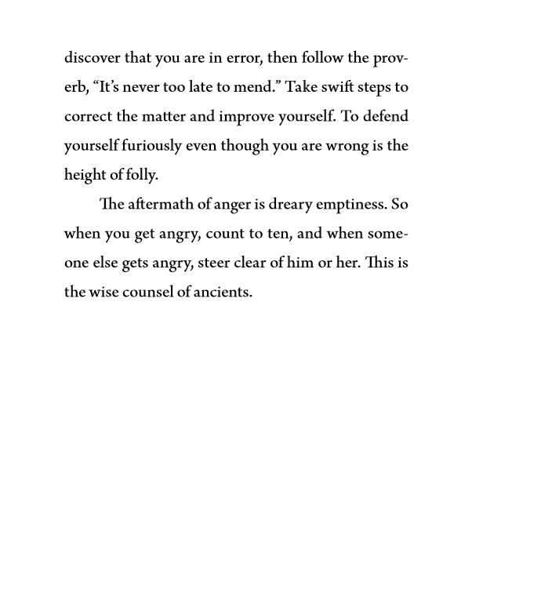

Slide 9
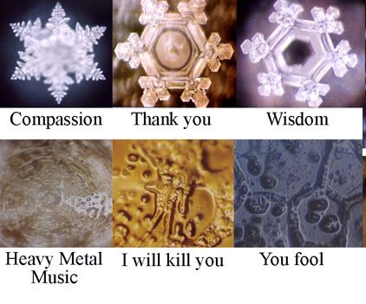
Dr. Emoto’s Water Crystal Images of Peace/Anger

Slide 10
We think patience is painful, and getting angry feels good. It’s feels good to “blow off steam”. Practicing patience is enduring our anger, and therefore hard to do.
It is easy to do what we feel like doing. This is called “desire” in Buddhism. Doing good deeds is not easy, such as doing patience because it is going against our desires.
It’s easy to be dirty, or late, or to spend money. These are desires. But it’s hard to do the opposite.

Slide 11
Buddhism teaches that anger arises…
1. When desire is interrupted
2. Attitude: “I am right, you are wrong”

Slide 12

1. When Desire Is Interrupted
5 Desires taught by Buddha
…Food
…Wealth
…Honor
…Sensual
…Leisure/sleep

Slide 13
Covina, California, Dec. 24 2008

Slide 14
2. “I Am Right; You Are Wrong”
When we have this attitude, arguments are bound to arise. No one likes to be told they are wrong.
We don’t like it when we feel we are being looked down on.

Slide 15
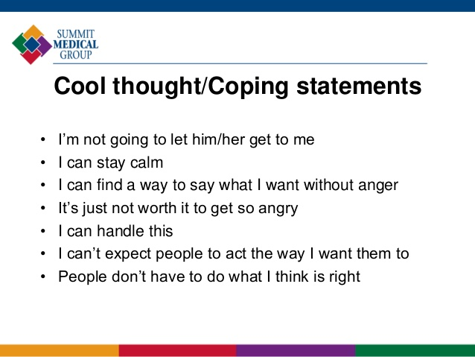
Methods Of Coping With Anger
Walking away from a bad situation.
Count to 10 when angry.
Without blaming, tell the other person that what they did hurt you.

Slide 16
Anger: productive/unproductive
Productive Anger:
Anger at others who are doing bad things, such as littering etc.
Scolding a child to teach better behavior. It is said to scold a child with tears in your eyes.

Slide 17
Unproductive Anger
Anger while trying to satisfy desire. Because I don’t get what I want, I get angry. Ex. Crimes of passion. It is Selfish
Scolding children by venting your anger – child abuse.

Slide 18
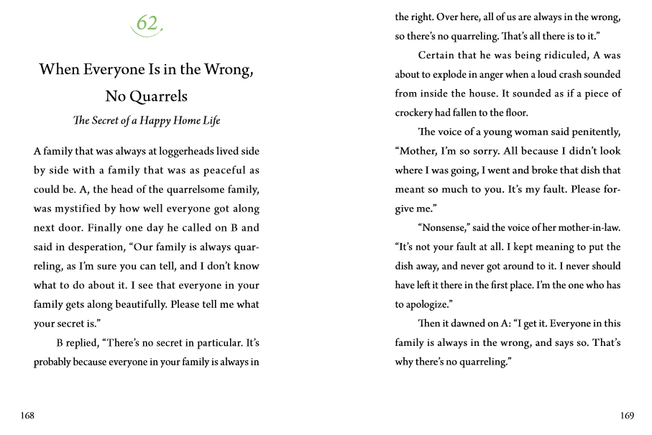
Something You Forgot #62

Slide 19
Now that we have learned about 3 kinds of situations, lets role Play
2 Persons: Expressing anger, blaming the other person.
2 persons: Expressing anger by expressing how their words or actions hurt you, and how you now feel angry.
2 person admitting they were wrong.

Slide 20
Anger ends in regret

Slide 21

Developing Patience

Slide 22
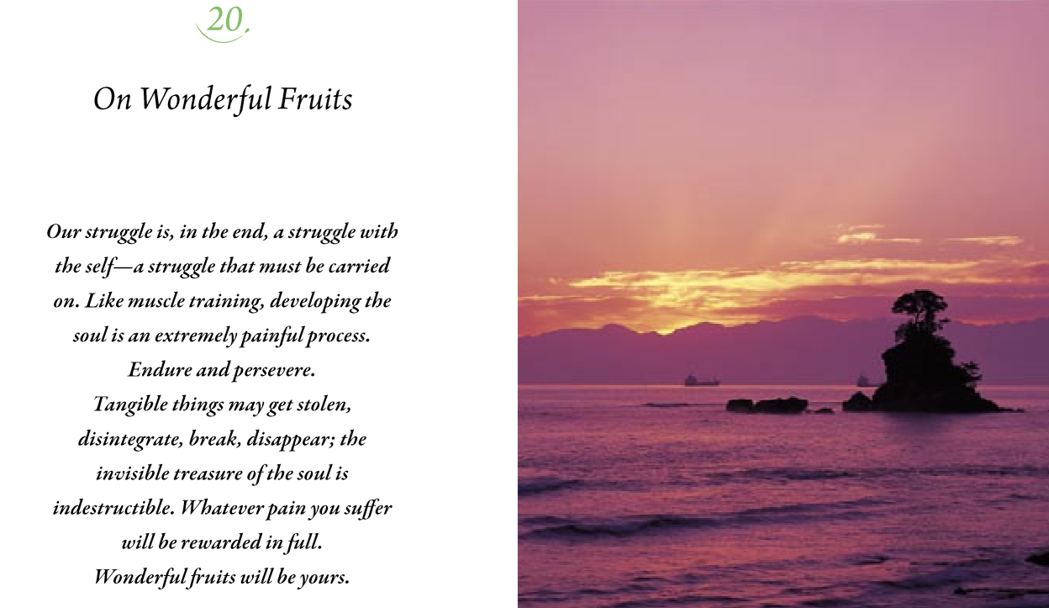

Slide 23
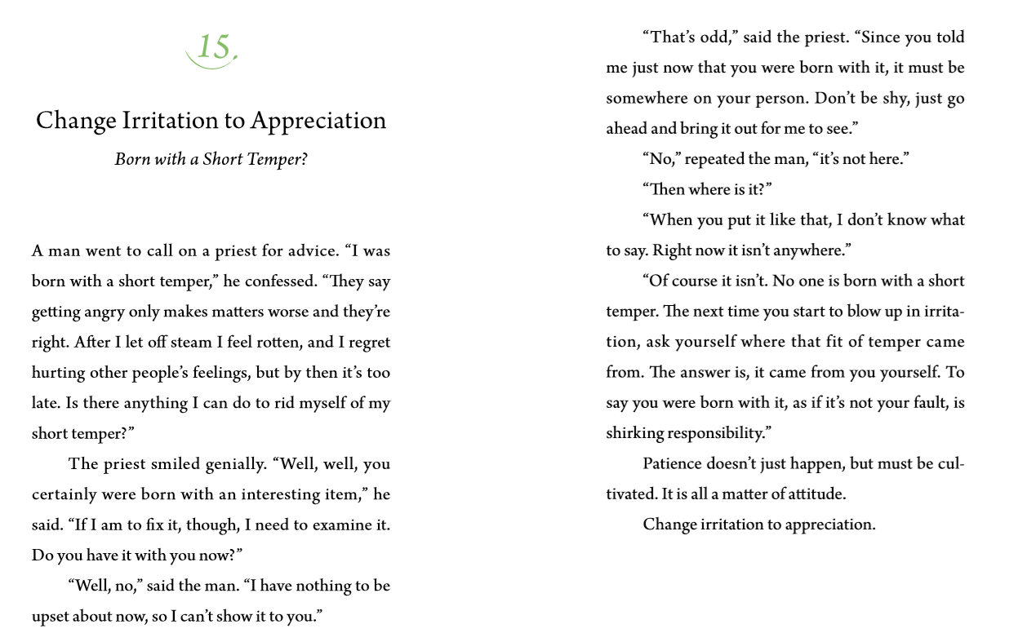
Something You Forgot #15

Slide 24
Patience

Slide 25
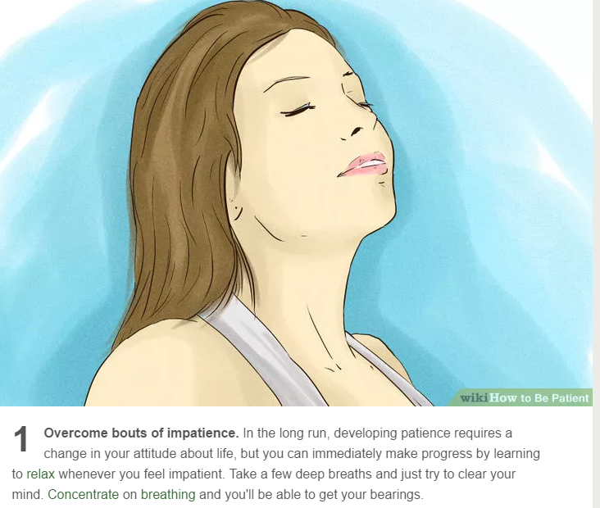

Slide 26
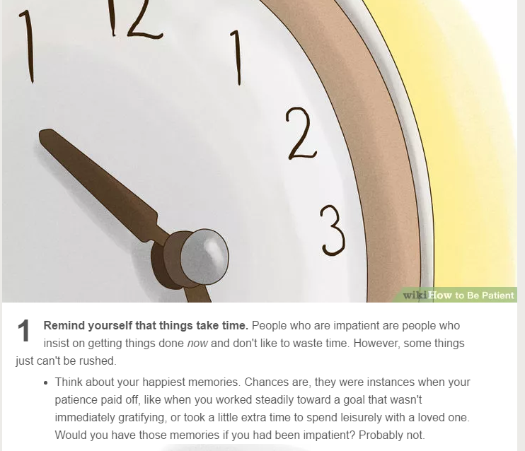

Slide 27
Summary
Patience is a good deed, a virtue. But difficult to do. Why? Because it goes against our desire.
The opposite of patience is Anger. When desire is interrupted, we get angry, teaches Buddha.
Buddhism also teaches that anger erupts when we think “I am right, you are wrong.”
The aftermath of anger is often regret and feeling bad.
There are many techniques that we can use to control anger.
Patience can be developed, like muscle training.

