Slide 1
The Six Paramitas
1. Kindness
2. Keeping promises
3. Patience
4. Making effort
5. Self-reflection
6. Wisdom (self-cultivation)

Slide 2
Self-reflection
It’s essential to find out why you think, say, and do certain things… then better yourself.
When do we need to reflect?

Slide 3
When we fail at something or when encounter misfortune.
Why at those times? Because of the Law of Cause and Effect (Karma)

Slide 4
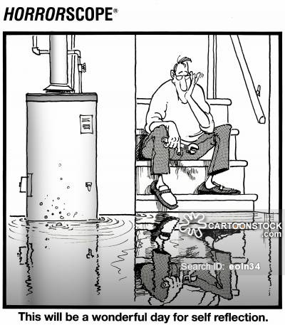

Slide 5
The Law of Cause and Effect
Good Cause, Good Effect
Bad Cause, Bad Effect
Own Cause, Own Effect
A bad effect (result) comes from a bad cause (action).
I reap the results of my own actions, good or bad.

Slide 6
The opposite of Self-reflection is…
….a scattered mind
A scattered mind is looking out. It is not focused on looking within.

Slide 7
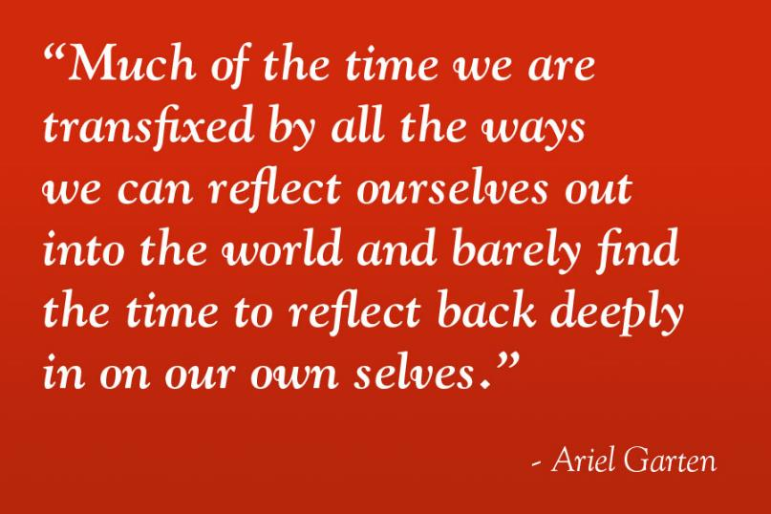

Slide 8
How to put our mind to use?
The saying goes, “A person’s worst enemy is their mind. A person’s greatest ally is also their mind”
We have control over how we use our mind.
We can make it our enemy or our ally.

Slide 9
Do we choose self-reflection, or regret?
It goes without saying that self-reflection is putting our mind to good use, making it our ally.

Slide 10
Bad results and blame
When we get a bad effect we tend to blame others and get angry.
When we are angry and blaming, we cannot look inside myself to reflect. We are looking outwards.
Our mind causes us suffering; it becomes our enemy.

Slide 11
Focus
In Self Reflection the focus is learning and improving.
With Regret the focus is on the past and feeling bad about the past.

Slide 12
Self Reflection
...is to turn eyes inward and look at myself as the cause, and improve.
Beacon: Story of the Raddish seller/SYF story #64

Slide 13
Self Reflection is focus on the future, and to do different... “the next time I will it this way.” Focus on the cause and want to change the cause.
As soon as we think of Self-reflection, we are already improving. It’s a good deed as soon as we practice it. We don’t have to wait for the result.

Slide 14
Regret
Regret focuses on the result and the desire to change the result. To change the result is the same as trying to change the past. It is focusing on the past, not the future.
“If I did not do that it would not have been like this...”

Slide 15
Self-Reflection
Regret
The focus is towards the future
Constructive/Improve ones actions
Positive action
From a good (positive) action, a good result will come.
The focus is on the past
Not constructive towards self -improvement
Negative thinking

Slide 16
Self criticism?
What about turning one’s eyes in, but being self critical? Since it’s turning one’s eyes in, is it a good deed?
It is negative. This is like regret.

Slide 17
There is no self affirmation with self criticism. Self affirmation is like life-affirmation. It is gratitude for my life. The teaching of Buddhism is about knowing the value of human life and the gratitude towards life.

Slide 18
What if we make the same mistake again?
If we make the same mistake it was not real self reflection.

Slide 19
Having a Buddhist mindset
“Don’t take pride in not making mistakes. Instead take pride in correcting mistakes immediately.”
“Lets not avert our eyes from suffering. Rather lets examine it closely.”

Slide 20
Levels of Reflection
With light reflection the results will last a year.
With deeper reflection, results will last 3 to 5 years.
With the deepest reflection results will last 20 years or more.

Slide 21

“On Self-Reflection”
“Everyone makes mistakes. Whether we put our mistakes to use depends on how deeply we reflect on our actions. It is desirable to reflect until tears come.”
(page 120)

Slide 22
Accepting the fault or not
The more responsibility we take for the bad result, the less pain we feel. The less responsibility we take, the more we suffer
If we can’t accept any of the fault we will suffer a lot.
However, If we can take 50% of the blame the suffering will be less.

Slide 23
In short the law is “Do good and stop bad.”
Make effort to do good.
If you want to stop getting bad results, then stop doing bad. If you want happiness, practice good deeds.

Slide 24
As the law teaches, the result never goes to others. It comes back to you and what you planted. Buddha taught us the Law for people to practice it. Listening means to put into practice.

Slide 25
Listening to Buddhism means learning deeply about my true self
The darker the shadow of a pine tree depends on the brightness of the moon. If the moon is not bright the shadow will be less. Likewise when you try hard to practice good deeds will you see the darkness within you.

Slide 26
Without light there is no shadow. The light refers to good, and the shadow to bad. We cannot move forward by thinking about the teaching. We have to practice.

Slide 27
Buddhists way of thinking
Common way of thinking
What can I change in my life?
I look within and find my flaws and work on them.
I’m always improving myself
My happiness grows
I have to find out who is responsible for my suffering.
I keep repeating this pattern there is no self improvement
I don’t get happier

Slide 28
Self reflection and humility
“I cannot condemn others
though their sins be red as wine,
For truly their offenses pale
next to those of mine.”
(From book Something, page 170)

