Slide 1

Sakyamuni Buddha

Slide 2
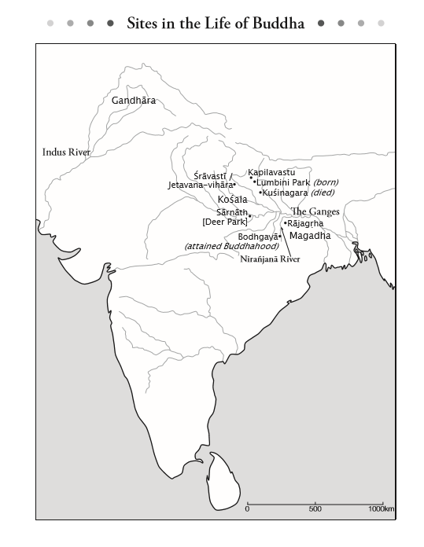
Buddha’s life overview
Born in India (south Nepal) 2600 years ago
April 8, in Lumbini
Prince Siddhartha
Lived in Kapila-vastu
Father and Mother: King Jobon/Queen Maya

Slide 3
Buddha’s life overview cont’d
Age 19 got married; had one child
Age 29, Feb.8, left the castle to seek true happiness
Age 35, Dec. 8 attained Buddha’s enlightenment
Age 80, Feb. 15 died
Taught Buddhism for 45 years. 7000+ sutras

Slide 4
Now, lets look at his life and teachings.
To begin with, we will look at the meaning of the “7 steps”.

Slide 5
The 7 (6 + 1) Steps
It said that when Buddha was born he took 6 steps, plus 1 (total of 7).
Why is the meaning of 6 + 1?
The 6 steps refer the ‘6 worlds of delusion’ or suffering that all sentient beings constantly transmigrate through.

Slide 6
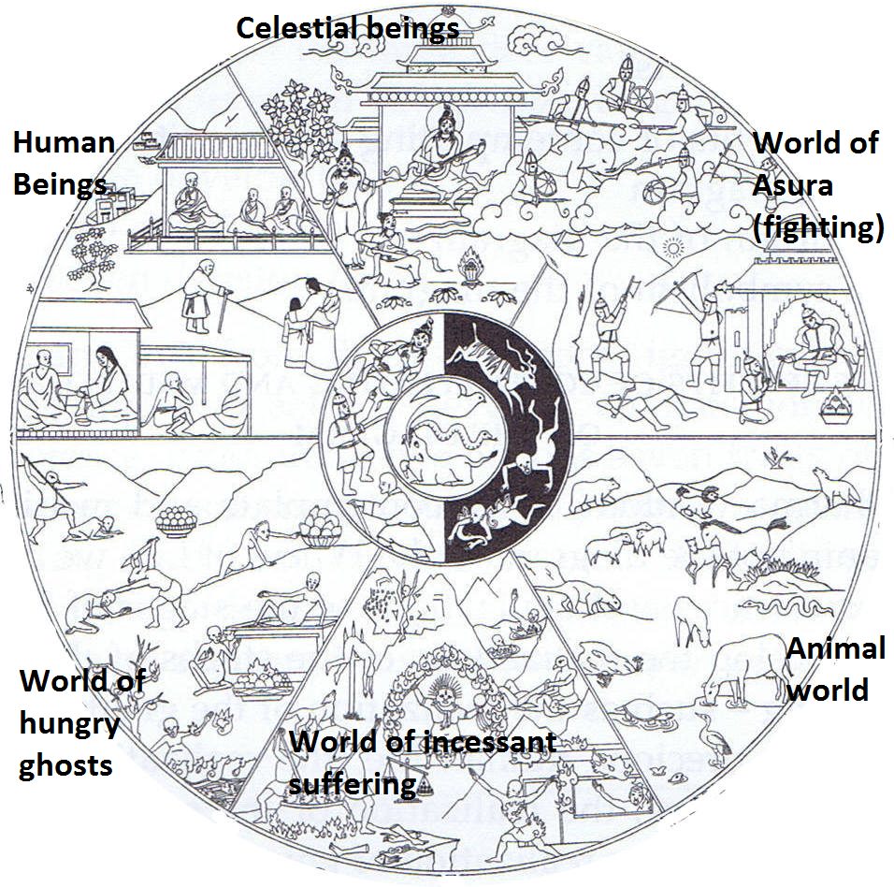
The 6 Worlds of Suffering

Slide 7
The 7th Step
Can you guess?
It is liberation from the 6 words.
Therefore Buddha, in his 45 years of teaching taught about the path to liberation from suffering. This is liberation from the 6 worlds.

Slide 8
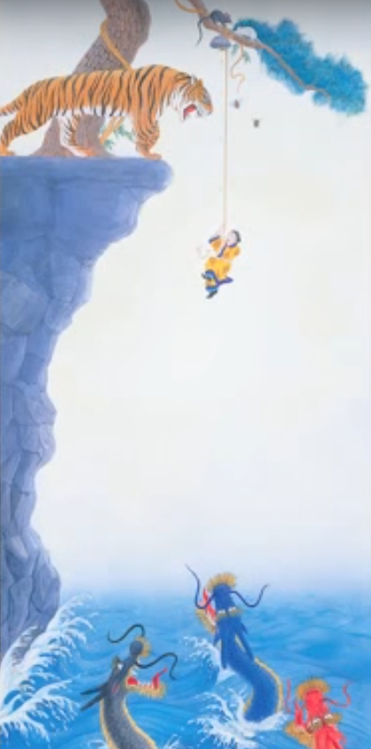
Why we fall into the 6 Worlds
The Reality of Mankind is a parable told by the Buddha.
In it he told how people are travelers on a journey through life, and who must fall into the 6 worlds in the afterlife.

Slide 9

Master Shinran’s explanation
“The endless wheel of Suffering.”
“Circling among the houses of the birth and death cycle.”

Slide 10
Master Shinran’s experience
“Never in all my lives in aeons past did I know the strong power for liberation. Were it not for the true teacher Genku, this life should have ended in vain as well.” – Master Shinran.
“I am, now, a foolish being imbued with evil and caught in the cycle of birth and death, constantly submerged and constantly wandering for all these countless aeons without ever a chance for liberation: this is clearly revealed to me.”

Slide 11

The 4 Gates
East Gate: Old age
South gate: Illness
West gate: Death
North gate: Ascetic practice

Slide 12
The 4 & 8 Suffering:
#2. Suffering of Aging
Physical strength declines
Gray hair appears
Wrinkling of the skin
Tire more easily
Memory worsens
Eyesight weakens
Hearing loss
Death of those around us
Lose hopes and dreams

Slide 13
The 4 & 8 Suffering:
3. Suffering of Sickness
Various disease: Heart disease, stroke, 100 forms of cancer, AIDS, Alzheimer’s, Parkinson’s...and so on, including various unknown diseases.
People are vessels for disease. A countless number of people have died from disease.
Each year globally, about 14 million people learn they have cancer.

Slide 14
The 4 & 8 Suffering:
4. Suffering of Death
Dying is the worst of suffering. We try to avoid thinking about it because it is so dreadful.
The severest punishment (capital punishment)
Everybody dislikes death, even animals.
We are scared of things such as, heights, being in an airplane, disease, going to the doctor.
Why? Because of the fear of death.

Slide 15
The Three Wishes
The young price could not forget about the heavy questions of his purpose in life.
His father wanted him to be a king, but the prince was consumed with finding answers to the meaning of life.
He said he would become a king if his father would grant him three wishes.
Lets read from The Story of Buddha page 110.

Slide 16
Three Wishes
Lets recall them…
The prince ask for freedom from:
1. Old age
2. Sickness
3. Death

Slide 17
Leaving the Castle
On Feburary 8, at age 29 the prince decided to act on his wish to find true happiness and he departed from life in the castle to go into the mountains to do ascetic practices.
Read from page 126

Slide 18
Enlightenment
After 6 year of harsh ascetic practice he finally attained his wish and reached enlightenment, and became a Buddha. It was December 8.
Page 194

Slide 19
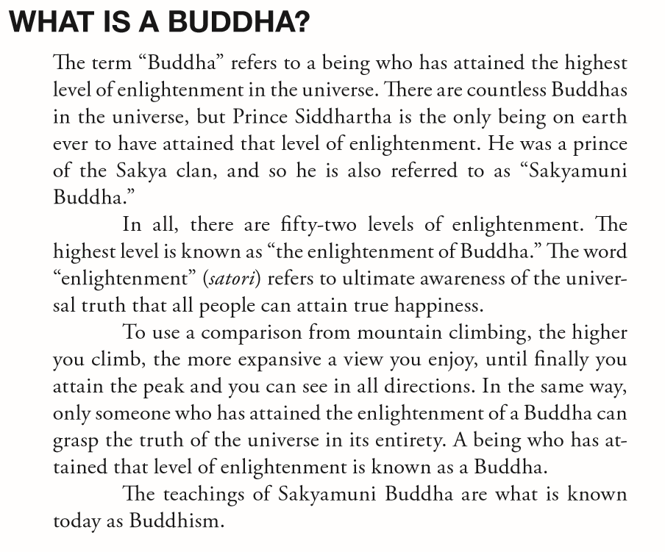

Slide 20
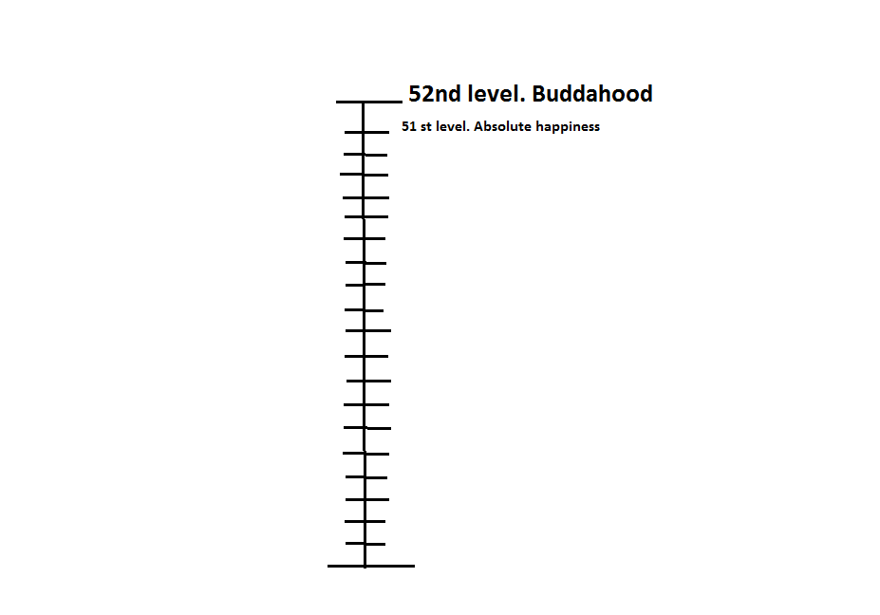
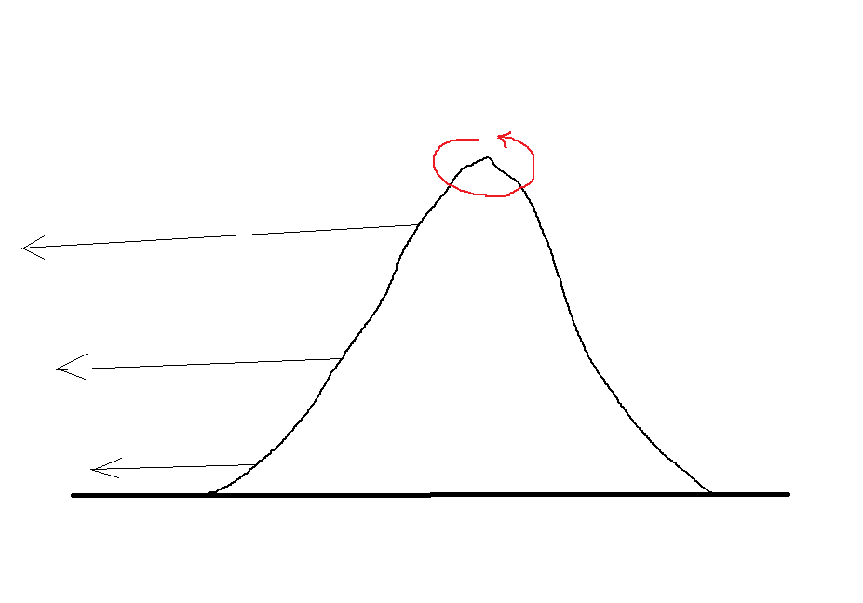

Slide 21
