Slide 1
The 4 and 8 Sufferings taught by Shakyamuni Buddha

Slide 2

“Life is Suffering”
Life is a tree that blooms flowers of suffering
Life is a succession of surmounting hardships.
Sufferings come in the form of hardships, challenges, adversity, natural disasters. Are we ever free of worry, anxiety, fear?
Notes:
Read page 54 of Reason.

Slide 3
1.Suffering of living
Working, studying, getting up in the morning, loneliness, not having enough money, traffic jams. All kinds of incidents and problems occur in our lives on a daily basis.
When we are in school we think longingly of graduating. When we have a job and earn money we find that working brings its own problems. We long for retirement. When retired we suffer from boredom and loneliness, and health problems. We might feel like a hamster in a cage running on a circular treadmill with no escape.

Slide 4
2. Suffering of Aging
Physical strength declines
Gray hair appears
Wrinkling of the skin
Tire more easily
Memory worsens
Eyesight weakens
Hearing loss
Death of those around us
Lose hopes and dreams

Slide 5
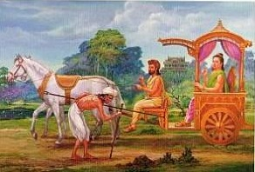
Prince Siddhartha / “The 4 Gates”
East gate
Encounter with an old person.

Slide 6
3. Suffering of Sickness
People are vessels for disease. A countless number of people have died from disease.
Each year globally, about 14 million people learn they have cancer.
Various disease: Heart disease, stroke, 100 forms of cancer, AIDS, Alzheimer’s, Parkinson’s...and so on, including various unknown diseases.

Slide 7
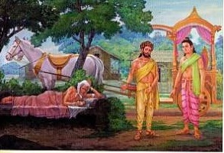
Prince Siddhartha / “The 4 Gates”
South gate
Encounter with a sick person

Slide 8
4. Suffering of Death
Dying is the worst of suffering. We try to avoid thinking about it because it is so dreadful.
The severest punishment (Death penalty)
Everybody dislikes death, even animals.
We are scared of things such as, heights, being in an airplane, disease, going to the doctor.
Why? Because of the fear of death.

Slide 9
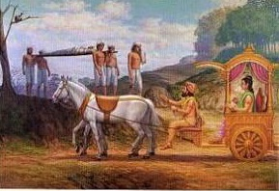
Prince Siddhartha / “The 4 Gates”
West gate
Encounter with a funeral

Slide 10
5. Being Separated from those we love
Parents, brother/sister, husband/wife, friends, boyfriend, girlfriend, pets…
Being unable to do something we love, such as sports or hobby.
Notes:
We all fear being abandoned.

Slide 11
6. Encountering things we dislike
The suffering of meeting persons we don’t like.
Having to go through something we don’t enjoy, such as surgery or taking an exam, public speaking.

Slide 12
7. Not getting what we want
We want things: a certain job or income, recognition, material possessions, a relationship, marriage, children, our dreams, physical appearance.
We are made of desire, teaches Buddhism.

Slide 13
8. The suffering of being of the flesh
An aggregation of all the above sufferings.
We suffer because of the existence of our own physical body.

Slide 14
The 4 and 8 Sufferings...
Are the sufferings which everyone experiences regardless of when or where we live, and regardless of our sex, wealth, or status e.g. if we are the president of a country or a homeless person. These sufferings are universal.

Slide 15
We try hard to cut off the flowers of suffering; however, since nutrients get to the tree through the roots, another flower of suffering blossoms.
Up to the moment we die, suffering does not cease.

Slide 16
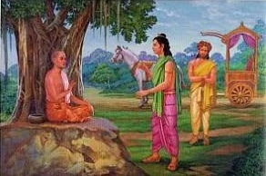
Prince Siddhartha / “The 4 Gates”
North gate
Encounter with an ascetic. The prince realized he could seek for something that would not be destroyed by old age, sickness and death.

Slide 17
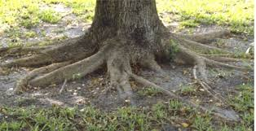
In order to attain true happiness, we must first identify the root cause of suffering.
Buddhism teaches clearly what the root cause of suffering is, and its solution.
If you keep listening to Buddhism, will attain happiness that surmounts old age, sickness and even death. You will experience the joy of being born human.

Slide 18
End

